Slide 1
SPECIAL EDUCATION FUNDING OVERVIEW
House Ways and Means Committee
Tom Melcher - School Finance Director
March 19, 2018

Slide 2
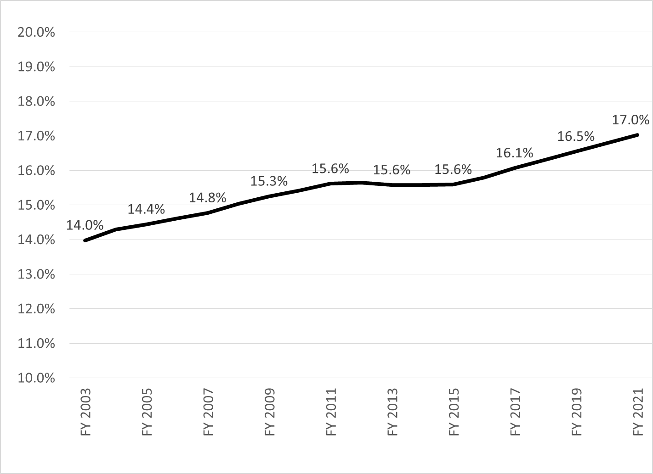
SPECIAL EDUCATION CHILD COUNT, BIRTH – 21
AS PERCENT OF TOTAL AVERAGE DAILY MEMBERSHIP, FY 2003 –FY 2021

Slide 3
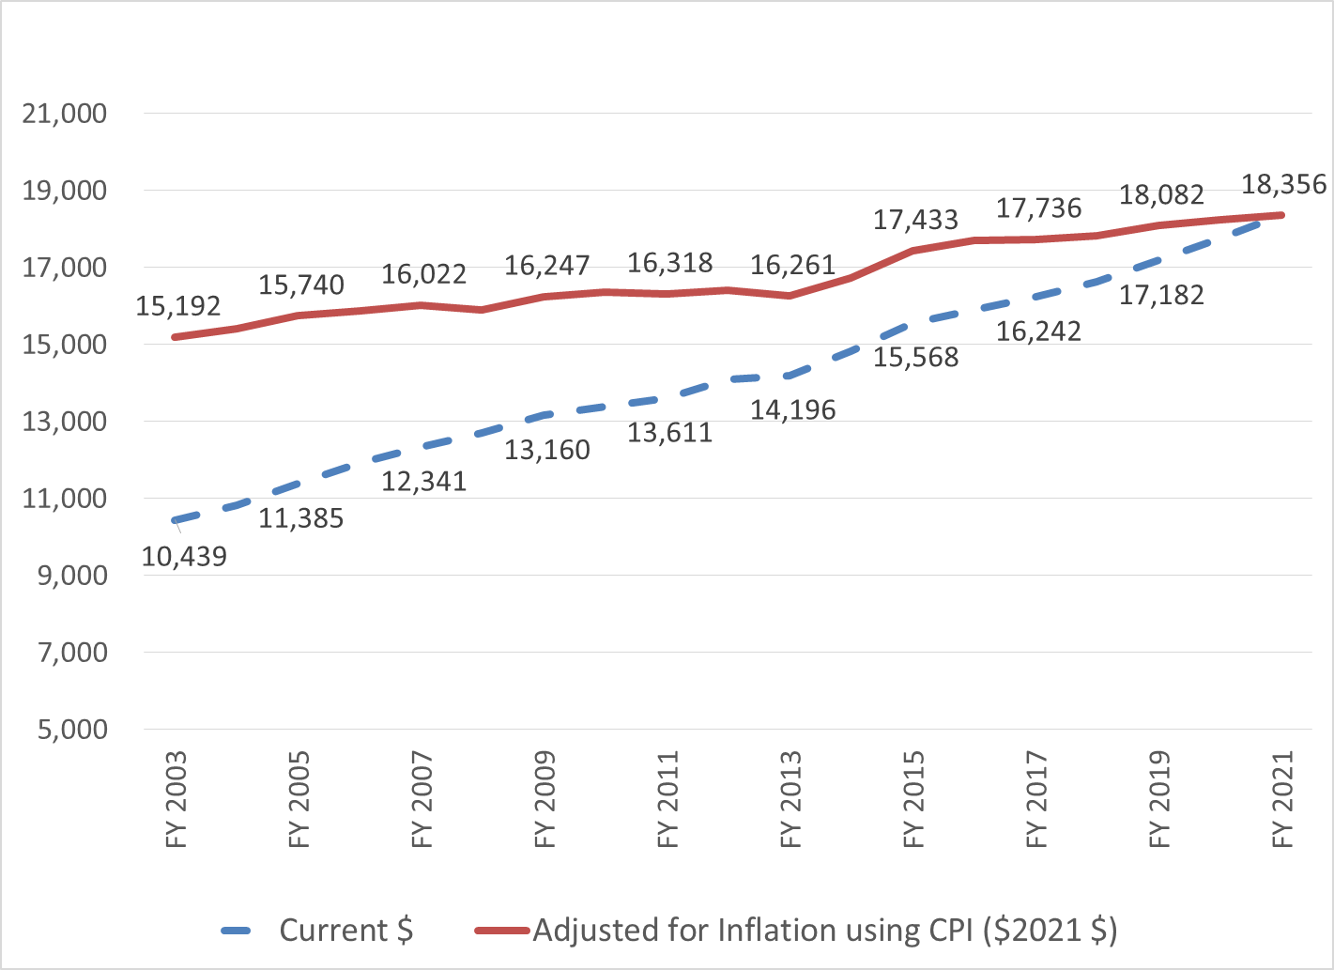
SPECIAL EDUCATION EXPENDITURE INCLUDING SPECIAL TRANSPORTATION
PER SPECIAL EDUCATION CHILD COUNT, FY 2003 – FY 2021

Slide 4
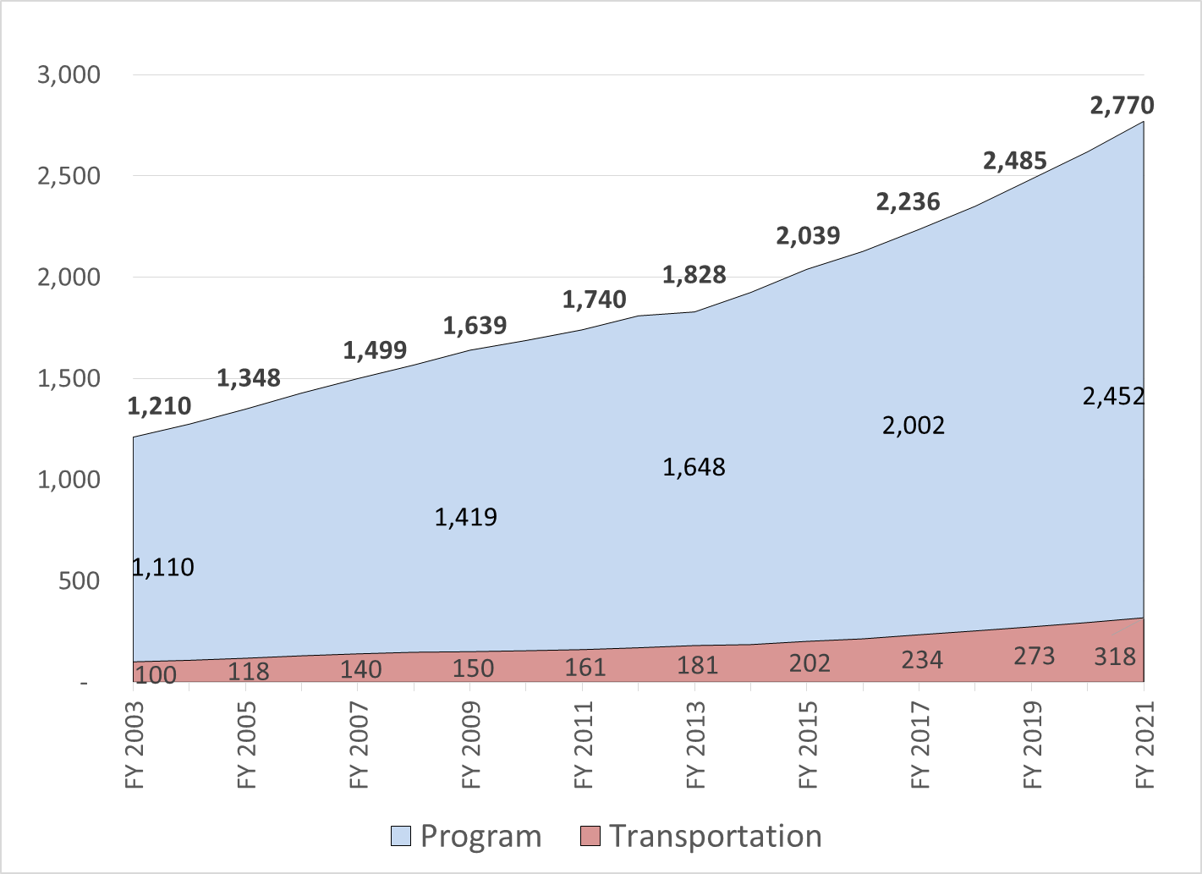
TOTAL SPECIAL EDUCATION EXPENDITURES, FY 2003 – FY 2021
Current $ in Millions

Slide 5
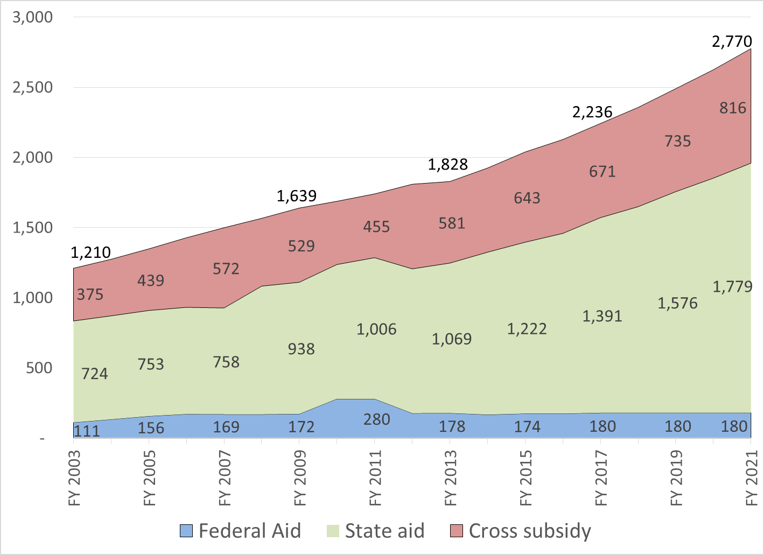
SPECIAL EDUCATION FUNDING, FY 2003 – FY 2021
Federal Aid, State Aid, and Cross Subsidy –Current $ in Millions

Slide 6
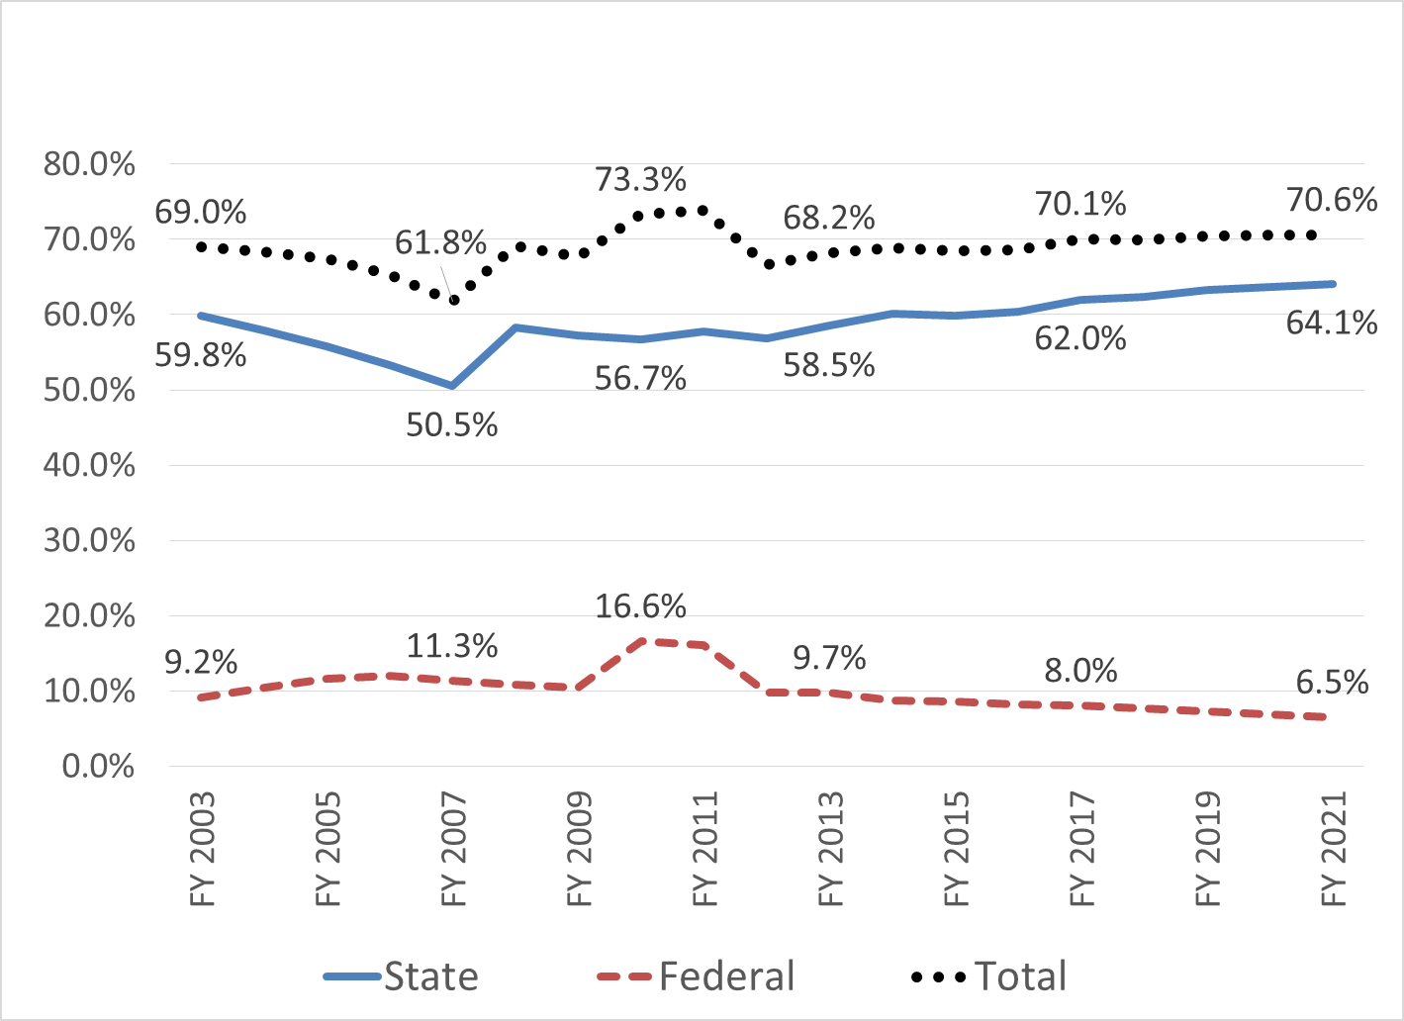
SPECIAL EDUCATION FUNDING
State and Federal Aid as Percent of Special Education Cost

Slide 7
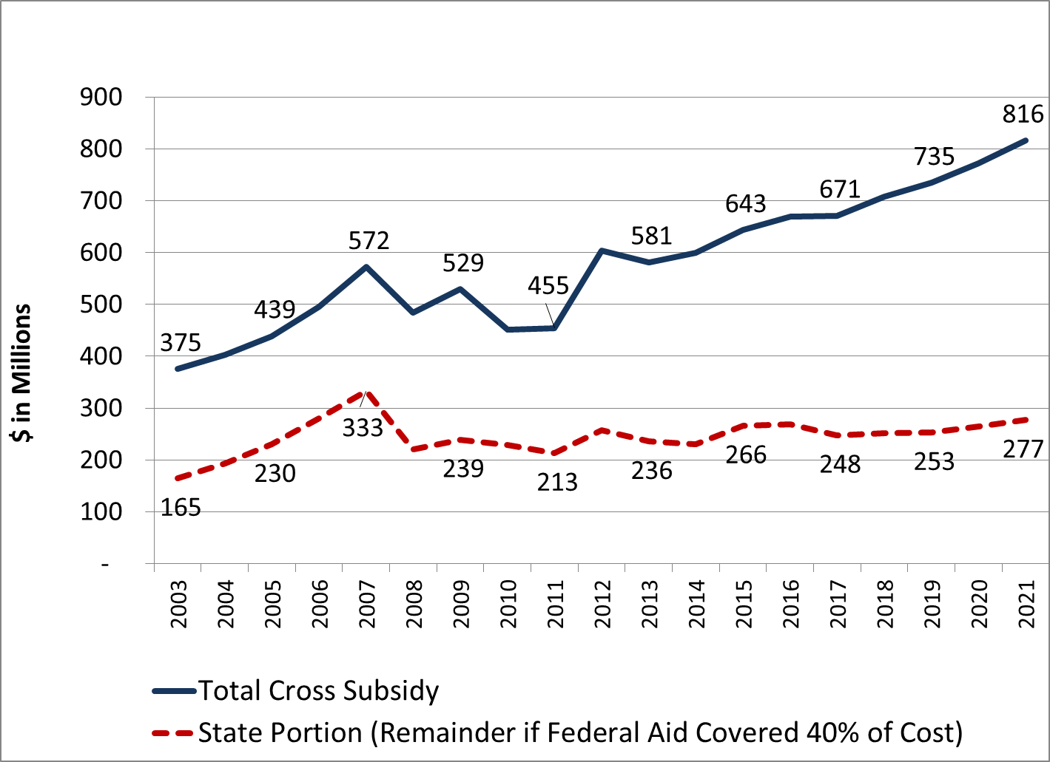
SPECIAL EDUCATION CROSS SUBSIDY
Total and State Portion-(if Fed Funding Covered 40% of Excess Cost), FY 2003 – FY 2021 Current $ (Millions)

Slide 8
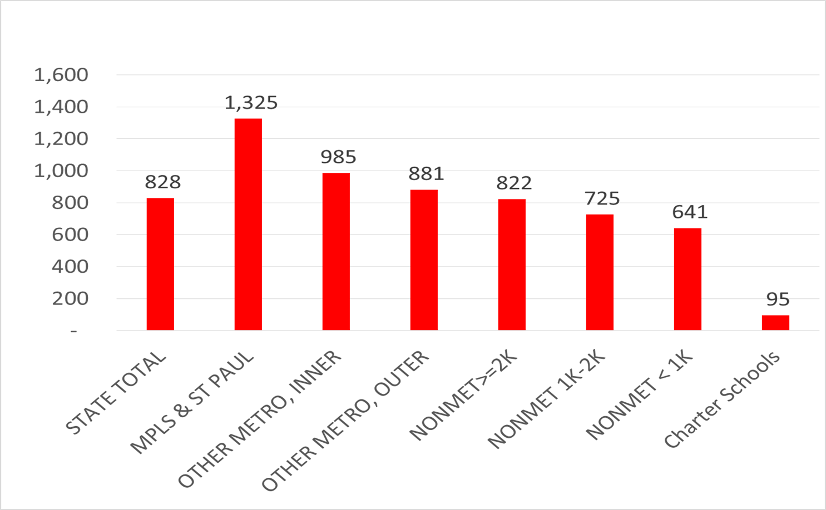
SPECIAL EDUCATION CROSS SUBSIDY
Per ADM Average by District Type, FY 2016

Slide 9
SPECIAL EDUCATION FUNDING FORMULA
Old Law (2012 Statutes)
  In effect through FY 2015
  Calculated using current fiscal year data
  Initial aid = 68% of eligible salaries + 52% of the difference between contracted service cost and applicable general ed revenue + 47% of special supplies &equipment. Fringe benefit costs not eligible for funding.
  Excess cost aid = 75% of the difference between reimbursable expenditures not funded with initial aid and 4.36% of general education revenue
  State total initial aid and excess cost aid were capped in state law, resulting in proration of initial aid and excess cost aid using a “statewide adjustment factor”. For FY 15, proration rates were 88.3% for initial aid and 67.6% for excess cost aid

Slide 10
SPECIAL EDUCATION FUNDING FORMULA
New Formula (Enacted in 2013, Effective FY 2016)
Scaled-down version of recommendations from 2012 education finance working group. Major working group recommendations included:
  Increase state special education aid by $150 - $200 million per year to reduce cross subsidies (the enacted increase was $40 Million);
  Replace the existing formula with a new formula to include the following changes:
    Eliminate the statewide cap on state special education aid;
    Expand reimbursable expenditures to include all special education costs not funded with federal aid, (primarily fringe benefits);
    Calculate aid using prior year data to improve predictability;
    Calculate part of the funding based on the number of students served by primary disability category and the statewide average cost per student by category; and,
    Require the serving school district or charter school (excluding intermediate districts, cooperatives and charter schools with more than 70 percent of enrolled students with IEPs) to cover 10 percent of unfunded costs for open-enrolled students

Slide 11
SPECIAL EDUCATION FUNDING
New Formula Mechanics: Initial Aid and Excess Cost Aid
(Calculated using Prior Year Data)
Initial Aid equals the sum of 100% of special transportation cost plus the least of:
  56% of the amount generated by a student-driven formula based on total ADM, number of students enrolled by primary disability, and statewide average cost per student by primary disability category;
  62% of old formula cost (excluding fringe benefits); or
  50% of total nonfederal cost (including fringe benefits).
Excess Cost Aid equals the greater of:
  62% of the difference between the old formula cost not reimbursed with initial aid and 2.5% of the product of the district’s general education revenue and the ratio of $5,831 to the prior year formula allowance; or
  56% of the difference between the total nonfederal cost not reimbursed with initial aid and 7% of the product of the district’s general education revenue and the ratio of $5,831 to the prior year formula allowance.

Slide 12
SPECIAL EDUCATION FUNDING
New Formula Mechanics: Tuition Adjustments
(Calculated using Current Data)
  For students placed by the resident district in a cooperative or intermediate district, or enrolled in a charter school with at least 70% special education students, 100% of the unfunded special education cost is added to the special education aid for the serving coop / school and subtracted from the aid for the resident district.
  For students open enrolling to another district or to a charter school with less than 70% special education students, 90% of the unfunded special education cost is added to the special education aid for the serving district / school and subtracted from the aid for the resident district.
  These are known as “tuition adjustments” because historically, the intermediate / coop / charter school / nonresident serving district would bill the resident district for its unreimbursed costs.
  For FY 2017, special education tuition adjustments totaled about $210 million statewide.

Slide 13
SPECIAL EDUCATION FUNDING
New Formula Mechanics: Hold Harmless and Growth Cap
    A hold harmless provision is included to ensure that no district will receive less aid than it would have received under the old formula for FY 16, adjusted in later years for inflation and enrollment change.
      69 districts received hold-harmless aid in FY 17 totaling $6.6 Million
    A district-specific growth cap which limits the increase a district can receive over what it would have received under the old formula for FY 16 to $80 per ADM. For later years, the base for the cap is adjusted for inflation and enrollment change in the district, and the limit over the adjusted base is increased to $100 per ADM in FY 17, with an annual increase of $40 per ADM in later years.
      121 districts were limited by the growth cap in FY 17, with the reduction to aid totaling $20.3 Million

