Slide 1
Direct Certification Medicaid Demonstration Project

Slide 2
Ten Minnesota Commitments to Equity
Prioritize equity.
Start from within.
Measure what matters.
Go local.
Follow the money.
Start early.
Monitor implementation of standards.
Value people.
Improve conditions for learning.
Give students options.
Notes:
TIP: If you are highlighting a specific item, select the list and change the color to Minnesota green. Then select the items you want to highlight and change the color back to white and bold.

Slide 3
USDA Purpose of DC-M Demonstration Project
To evaluate potential of direct certification with Medicaid data to—​
Identify students who are eligible for free and reduced price school meals but are not certified for them​
Directly certify students who are currently enrolled in school meals programs based on a household application ​
Assess effect on Federal costs and participation​

Slide 4
Eligibility
Eligible child must meet both criteria—​
Receives Medicaid or lives in household with another child who receives Medicaid, and​
Has family income as measured by the Medicaid Program, before application of any disregard, including an expense-related, block, or other disregard, that does not exceed National School Lunch Program (NSLP) demonstration income standards applicable to family size.​

Slide 5
Eligibility Cont.
NSLP income eligibility standards will be used in the demonstration projects—​
130% of the Federal Poverty Level (FPL) for free meal eligibility​
185% of the FPL for reduced price meal eligibility​

Slide 6
Project Policies
Participating States must conduct direct certification for both free and reduced price school meals in all local educational agencies (LEAs) participating.​
Children directly certified are not required to submit applications for free and reduced price meals and are not subject to verification procedures.​
Households directly certified for reduced price meals must be notified of the income level used and offered the opportunity to apply if they think their income is within the standard for free meals.​

Slide 7
Project Policies Cont.
Children determined eligible to be directly certified for free meals based on Medicaid data are not categorically eligible for meal benefits since they must meet an income standard. ​
State agencies/LEAs must use automated data matching with Medicaid eligibility records to directly certify students.​
LEAs must not certify based on family providing a Medicaid case number or letter from Medicaid agency.​
Students already certified for free or reduced-price meals based on an application or direct certification with another program must not be negatively impacted by match with Medicaid​

Slide 8
Direct Certification Reporting
SNAP, MFIP & other direct certification matches always supersede Medicaid matches for reporting purposes.​
Identify as a Medicaid match only when child does not match with SNAP, MFIP, or other programs (i.e., Foster)​
Priority Order-- ​
SNAP MFIP Foster Medicaid​
Direct certification rate
Currently 100 percent (based only on SNAP)

Slide 9
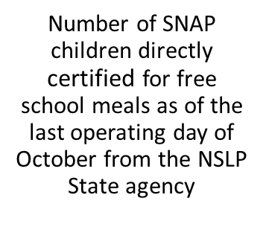
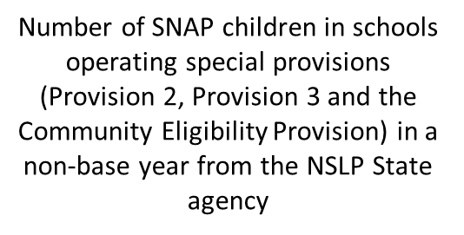
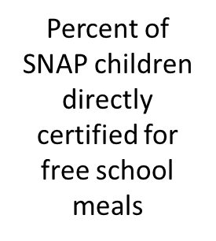
Direct Certification Rate
Definition:
A formula that has been created by the United States Department of Agriculture (USDA) to calculate children/students automatically eligible for free meals.

Slide 10
What this means for schools...
Training and technical assistance from MDE
Expanded direct certification matching including Medicaid student matches for free or reduced priced meals
Modified direct certification reports with additional reporting of Medicaid matches
Modified direct certification data file for schools to upload into their point of sale (POS) systems. This change will require schools to obtain assistance from vendor to modify their system accordingly
Process modification to account for new directly certified reduced price students

Slide 11
Questions

