Slide 1
Rural Minnesota Foodservice Funding and Issues
MREA
Melissa J. Elder, MS –Supervisor, School Nutrition Business Operations
November 13, 2023

Slide 2

Training Objectives
Four Key Objectives.
Discuss MN Free School Meals impact on rural schools.
Identify common financial challenges School Nutrition Programs in Rural MN face/identify solutions.
Explain 3 school nutrition nonprofit foodservice fund ‘compliance confusion areas’.
Identify steps to ensuring financial integrity of nonprofit school foodservice accounts in rural schools.

Slide 3
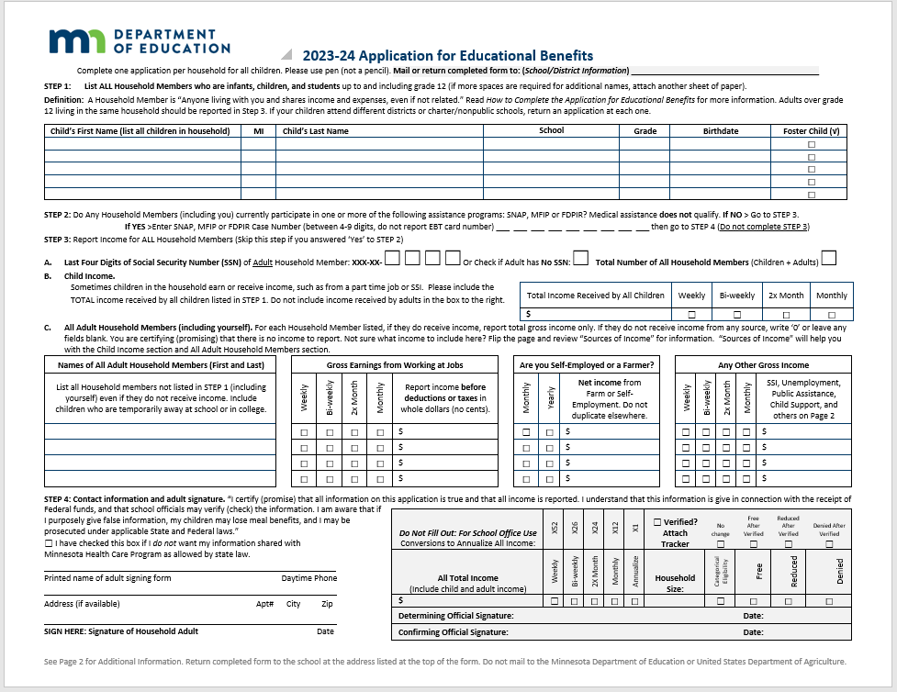
Objective 1 – Discuss MN Free School Meals
Permanent Funding Signed into Law in 2023.
Why Understanding the Funding is Important!
Applications for Education Benefits – Why Rural Schools Need to Collect!

Slide 4

Objective 2 – Identify common challenges School Nutrition Programs in Rural MN face
Common Challenges
Staffing
Infrastructure limitations
Using the foodservice funds for allowable expenses only
Limited purchasing options

Slide 5

Objective 2 – Let’s Find Solutions
Possible Solutions
Know who and how employee labor can be charged to foodservice
  Keep really good records!
Infrastructure---Know what can and cannot be charged to foodservice
  Is what you need to fix permanent to the building?
Don’t miss out on every piece of available funding!
Purchasing---Get creative! Buying power is key.

Slide 6

Objective 3 – Foodservice Fund Financial Compliance Confusion
three ‘compliance confusion’ areas identified.
1. Allowable vs. Unallowable Costs
2. How expenses are charged to program
3. Unallowable expenses when procuring or contracting out program management, goods or services

Slide 7

Allowable costs
7 CFR 3016 and 3019 state that food service funds may be used only for allowable costs.
Organizations in Federal government have principles for determining allowable costs. Those that affect child nutrition programs are Office of Management and Budget (OMB) circular A-87 for public schools and A-122 for private non-profits.
Costs must be:
  Necessary
  Reasonable
  Allocable
  Allowable
  Consistently Allocated

Slide 8

State Statute: MN 124D.111
124D.111 LUNCH AID; FOOD SERVICE ACCOUNTING.
(c) Revenues and expenditures for food service activities must be recorded in the food service fund.
The costs of processing applications, accounting for meals, preparing and serving food, providing kitchen custodial services, and other expenses involving the preparing of meals or the kitchen section of the lunchroom may be charged to the food service fund or to the general fund of the district.
The costs of lunchroom supervision, lunchroom custodial services, lunchroom utilities, and other administrative costs of the food service program must be charged to the general fund.
IS IT NECESSARY?
IS IT ALLOCABLE?
IS IT REASONABLE?

Slide 9
Unallowable Expenses when Procuring or Contracting Out Management or Services
Unallowable expenses when procuring or contracting out program management, goods or services
Foodservice Management Company Charging Start-Up Fee without Contract Terms
Capital Expenses –Improvements to Building
Procurement—Distributor Writing Bid Specs and then Bidding

Slide 10

Examples of Allowable Costs from OMB Circulars 87 and 122
Food purchases
Labor
Cleaning
Food Service Equipment and Supplies
Training Supplies
Food service related meetings/travel
Memberships to food service related publications
Computer/technology used exclusively for food service.
Custodial used only for food service program
Utilities when accounted for on a separate meter from the rest of building
Advertising
Promotional Materials
Automotive equipment/maintenance used only for food service department.
Printing/Copying for food service dept.
Full-time food service employee meals

Slide 11


Examples of Unallowable Costs
Bad Debt
Purchase land, acquire or construct buildings or make alterations to existing buildings that materially increase the value of capital assets
Contributions or donations to a cause
Entertainment, amusements, social activities
Interest on borrowing
Rent or usage fees for sponsor owned facilities

Slide 12
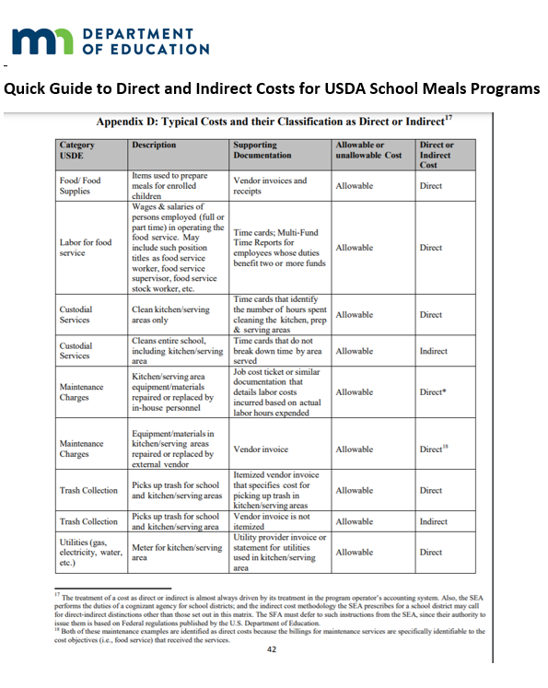
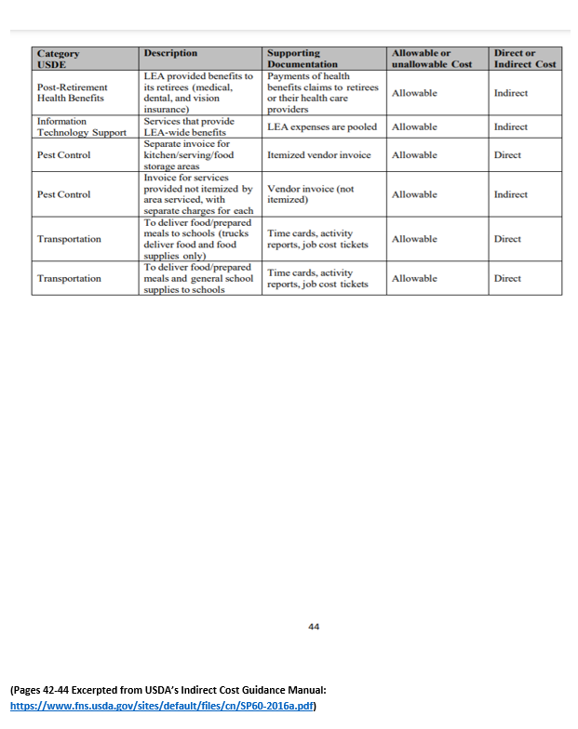
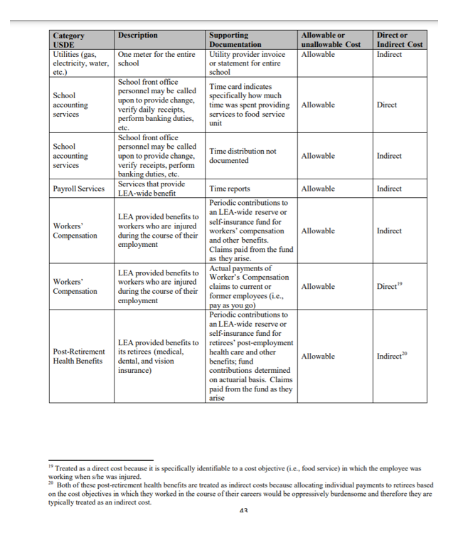

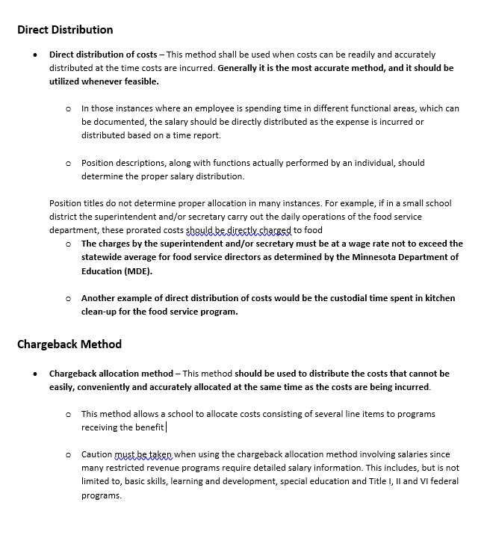
Do You Have Documentation?
Direct
OR
Indirect
Cannot do Both

Slide 13



Objective 4 - 2 Steps to Ensuring Financial Integrity.
two steps to ensure financial integrity.
1. Put Internal Controls in Place
2. Ensure Foodservice Revenue Restricted

Slide 14
Financial Integrity
Financial Integrity=Protect the Nonprofit Foodservice Account.
Program Requirements
Develop and Implement Internal Controls
Program Integrity
Yearly evaluation of shared facilities/maintenance costs
Contracts evaluated annually
Capital Improvement costs unallowable
Revenue restricted to foodservice operations

Slide 15



Minnesota Department of Education
Nutrition, Health and Youth Development
Toll Free: 800-366-8922 or Local: 651-582-8526
Email: mde.fns@state.mn.us

