Slide 1
Managing Screens using the Wisdom of Harm Reduction
Leah Persky, PhD & CFLE
Jewish Family and Children’s Service of Minneapolis
MREA 2023​

Slide 2
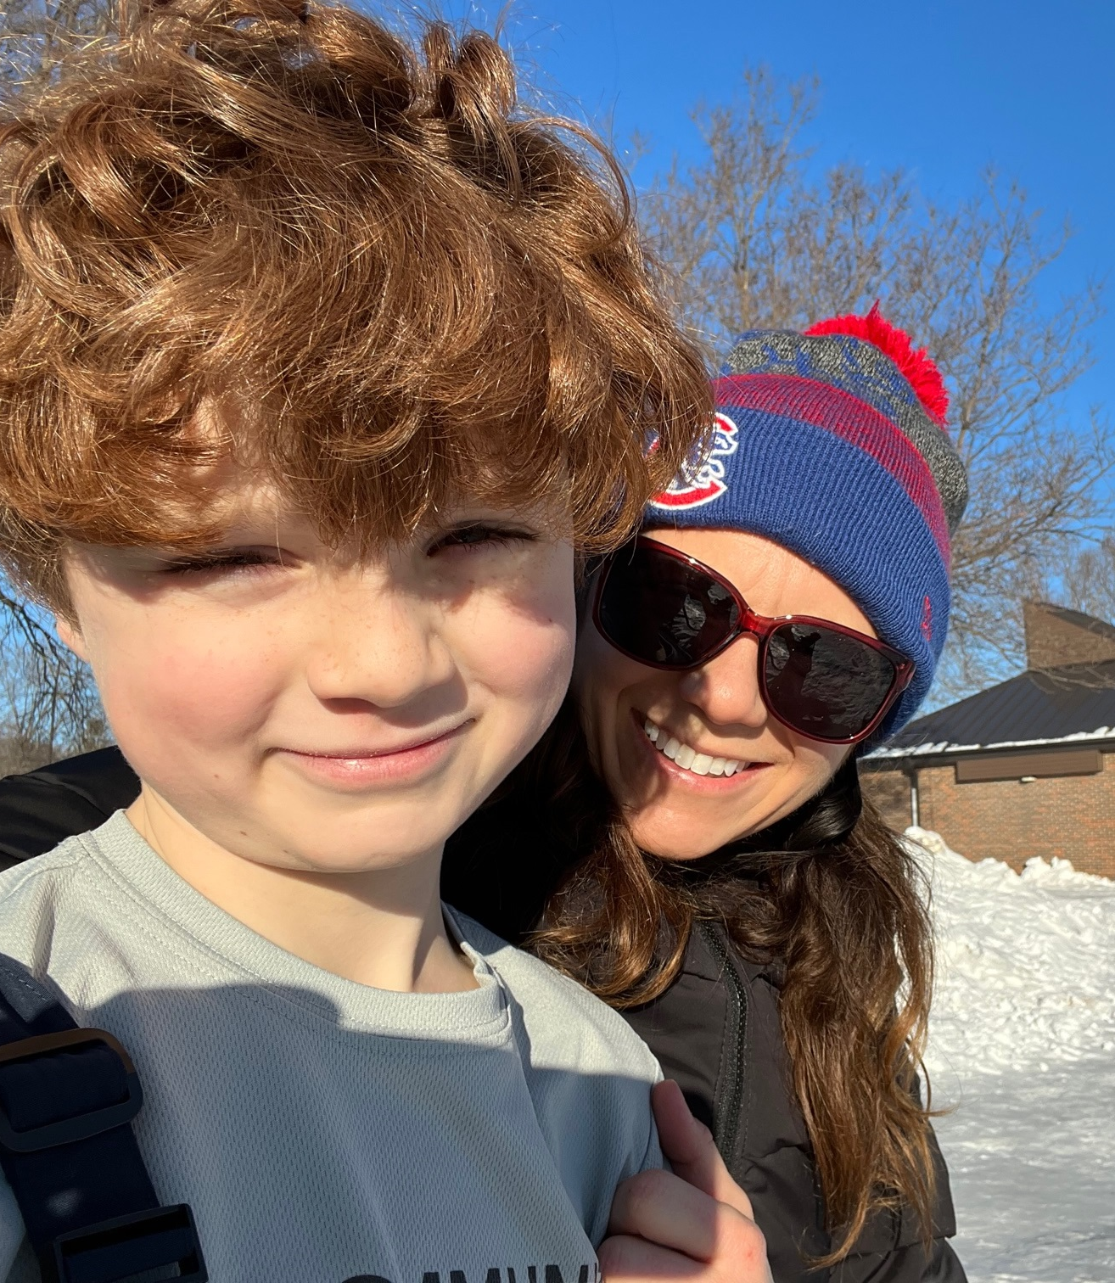
The Why behind the topic
Notes:
As a parent coach and manager of community education
My 8 year old had to get a phone for his medical condition

Slide 3
Objectives
1) Explore what media usage look like today for children
2) Discuss the diverse impacts of ‘screen time’ on kids
3) Explore why it is so challenging to monitor ‘screen time’
4) How and why location matters with a focus on rural areas
5) Define and understand the principles of Harm Reduction
6) Strategies to manage screen time use for digital natives
7) When and why to seek help.
Notes:
A challenge during the presentation: put your phone away, unless you need it for some reason then self-monitor your urge to use your cell phone or computer. How many times do you want to reach for it, how many times do you check it?
Make this a safe space

Slide 4
Reflection
What are you most concerned about when it comes to the use of ‘screen time” for your children and/or students you work with?
Notes:
Have audience members turn to each other to discuss for a few minutes

Slide 5
Notes:
CS Mott Children’s Hospital National Poll- University of Michigan Health

Slide 6
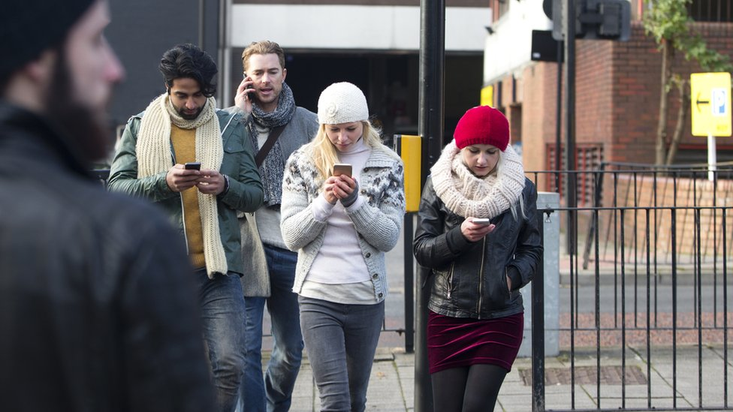
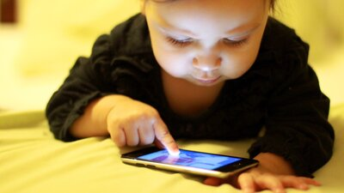
What does screen Time Mean Anyway?
Notes:
Social media first developed in 1997
First smart phone was released in 2007
2011-2012 is when we see most Americans owning a smart phone
Kids are digital natives, screen time is an outdated view of their world
This is changing our lives in very real ways.
68% of parents they feel distracted by their phone when they are with their kids (Pew research center)-2020 https://www.pewresearch.org/internet/2020/07/28/parenting-children-in-the-age-of-screens/
Gen Z- those born in the late 1990’s are digital natives, they are the first generation to be so. They have no memory of the world without smart phones
Do you remember getting your first cell phone or smart phone? That changed our lives in very pronounced ways!
This is a story about adults and kids

Slide 7
How much of our Day Do we spend online?
Notes:
Focus on adults here: Ask for a few responses from the audience.
In 2021 Pew Research, 3/10 (31%) of adults say they are online almost constantly only 7% of adults say they don’t go online at all
In 2021, adults in the U.S. spent an average of 485 minutes (eight hours and five minutes) with digital media each day. This figure marked an increase of 11 minutes compared to the previous year.
The number is closer to 11 hours per day if you factor into it daily use of smartphones, computers, video games, radios, tablets and TVs. (Neilson Company)
That means we are spending and using nearly half of our time waking time each day staring at the screen.
Adults unlock there phone at least 150 times per day and We tap, swipe, and click on our phones 2,617 times per day (King Online University).
https://www.inc.com/john-brandon/these-updated-stats-about-how-often-we-use-our-phones-will-humble-you.html
https://www.pewresearch.org/fact-tank/2021/03/26/about-three-in-ten-u-s-adults-say-they-are-almost-constantly-online/
A Guttman, (2023) https://www.statista.com/statistics/262340/daily-time-spent-with-digital-media-according-to-us-consumsers/
Howard, Jacqueline. “Americans at more than 10 hours a day on screens.” CNN, Cable News Network, 29 July 2016, www.cnn.com/2016/06/30/health/americans-screen-time-nielsen/index.html.

Slide 8
Kids: How Much Time?
Notes:
https://meetcircle.com/pages/screen-time
AAP, around 7/hours per day 2021- https://www.aap.org/en/patient-care/media-and-children/

Slide 9
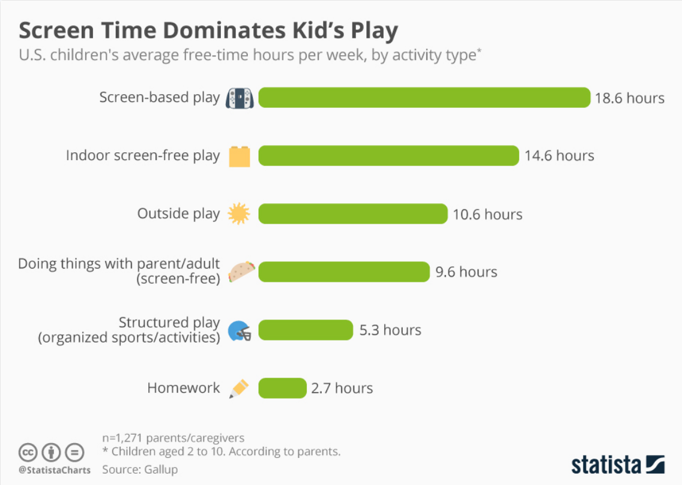
How kids spend Free time
Notes:
Kids are digital natives
Data from 2017 (2-10 year olds)
https://www.statista.com/chart/11651/screen-time-dominates-kids-play/
In general for all kids, the most common thing they do online is watch videos of all kinds and stream content, next biggest category is social media and communication (messaging), then video gaming and the shopping.
There are important gender dynamics to be aware of here as well– boys play more video games and watch videos while girls spend more time on social media and communicating with friends
Links to teen mental health crisis.

Slide 10
diverse impacts of ‘screen time’

Slide 11
Diverse Impacts
Notes:
The evidence around the impact of screen time is confusing and contradictory
That is partly why this is so hard to manage for ourselves and the kids in our lives
Many questions here: what are they doing online, what is media diet, how do they feel afterwards, time spent, are they avoiding or changing behaviors, seem dysregulated . . .
We often hear of sensationalized parts of this conversation in the news, there are real differences between extreme use and normal or heavy use

Slide 12
Impacts on Health of Children
PROs
Connection & Community
Learning Opportunities
Self-Expression
Identity Formation
Entertainment
Fine motor skill development
CONs
Negative impacts on sleep
Mental health challenges
Cyber-bullying
Increased exposure to advertisements
Body image & confidence concerns
Potential security concerns
Obesity Risks Increase
Developmental Concerns*
Notes:
Researchers have worked for decades to tease out the relationship between media use and mental health in kids. Although there is debate, the evidence I have seen so far is complex, inconclusive and often contradictory
With extreme use in young children or with significant use in older children without other healthy activities on a daily basis- critical thinking, learning and observing, language skill development and social emotional learning can be impacted

Slide 13
Inconclusive
Causation is hard to establish
Correlation and Association present, but. . .
Evidence is complex, there are many variables
Often reliant on teen self-reporting- negativity bias
Gen Z are the first fully digital natives (born in mid to late 1990’s)
What we often hear in the news:
Shorter attention span
Correlation between depression and social media use in teens
Safety concerns
Notes:
The question is how much and do you have digital literacy?
Researchers have worked for decades to figure out the relationship between media use and mental health in kids. Although there is debate, the evidence I have seen so far is complex, inconclusive.
Social media can trigger feelings of ‘compare and despair’ – envy, shame and guilt and low-self-esteem- this can trigger feelings of anxiety, episodes of depression and mental health disorders, there is also a correlation between rise of social media use and many mental health disorders, but causation is very hard to establish. Also how much use are we talking about, moderate use is very different than extreme use.
Based on my research, the areas I am most concerned about are: sleep, social emotional regulation and depression

Slide 14
Why is this so hard?
Notes:
Marc Maron and Gavin Aung (2013)
Zenpencils.com

Slide 15
Why Is This so hard?
SCREENS are a Huge Help
Being a ROLE MODEL IS HARD
Feelings of overwhelm
- There is so much to learn & monitor
- I am not “techy”
- I don’t want all those apps
- Confusion & Drama
- Babysitter especially for younger children
-Timesaver
Modeling the behavior we want to see in our children/students is a challenge
Notes:
Question to group/small group:
what are the hardest times at your school as it relates to managing screens for students? Why is it so hard?
When are the screen free times?

Slide 16
How and Why Location Matters Strength & Challenges for Rural Areas
Notes:
Take a moment and turn to the person next to you.
In what ways do you see this conversation being impacted by location? Specifically how do children and families in rural areas different use or rely on screen time differently?
Access is one big issue, with lack of access to broadband by many and transportation issues being real. The lack of access to mental health and all health practitioners is also a challenge that can be improved by telehealth access, again reliant on internet access.

Slide 17
Notes:
There remains a digital divide
Many rural areas are underserved
Speedy and stable internet connections allow students to learn remotely, patients to visit with doctors using telemedicine, and commerce to continue.
https://www.house.mn.gov/sessiondaily/Story/17045

Slide 18
Strengths
Close Knit Communities with strong community bonds
Cleaner environments and more outdoor activities
Lower levels of crime
Culture of innovation and adaptability
Lower levels of stress
Lower cost of living
Increasingly diverse
Strong economic contributors to state revenue

Slide 19
Challenges
Policy often geared towards urban schools, needs of rural schools often neglected or not seen
Fewer mental health professionals to support community
Uneven access to high quality internet connections
Transportation challenges
Teacher recruitment and retention hits many rural areas especially hard
Declining enrollment in some locations, impacts funding
Smaller enrollments lead to inequity in funding streams

Slide 20
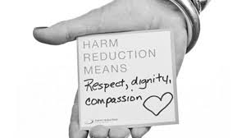
What is Harm Reduction?
Notes:
Refers to an approach designed to reduce the harmful consequences associated with potentially higher risk activities
It is holistically different to abstinence only models. Informs public policy and work in the addictions sphere, but there is a wider applicability
Works on the Individual, family, community levels
Why is it needed? Screens are here to stay, parents and teachers cannot control all or keep up, change is inevitable, many adults feel overwhelmed

Slide 21
Harm reduction is focused on minimizing consequences without needing the activity to stop. Harm reduction is a well-researched, evidence-based approach shown to be effective in addressing substance related harms (minimizing death, disease, and injury). Harm reduction is the only global drug policy response that has proven to save lives and money at the same time as increasing quality of life. Stone & Sander, 2016
Notes:
A common sense approach

Slide 22
Harm Reduction Strategies
What can be done to lessen the negative impacts of media use? Child Focused
Unique to each contexts, no one size fits all model
Begin to monitor behavior before and after use. Let that help guide you
Look at age-appropriate guidelines
Set realistic boundaries on screens: ex. no screens while eating.
Focus on strengths
Notes:
APA recommendations

Slide 23
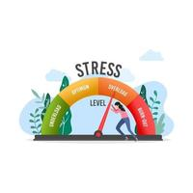
Harm Reduction Strategies What can be done to lessen the negative impacts of media use? adult Focused
Care for yourself, be mindful of your stress levels and media diet
Communication is the foundation
Be the role model
There are many paths
Keep it Simple and Authentic
Be Dynamic
Avoid the sensationalism
Notes:
As a parent coach people ask me, if their child’s behavior is normal or if the kids are doing okay. I always respond the same way, how are you doing? How are the teachers doing? How are the other caregivers doing?

Slide 24
Case Studies
16-year-old video gaming
12- year old phone use in school
5-year-old tablet use

Slide 25
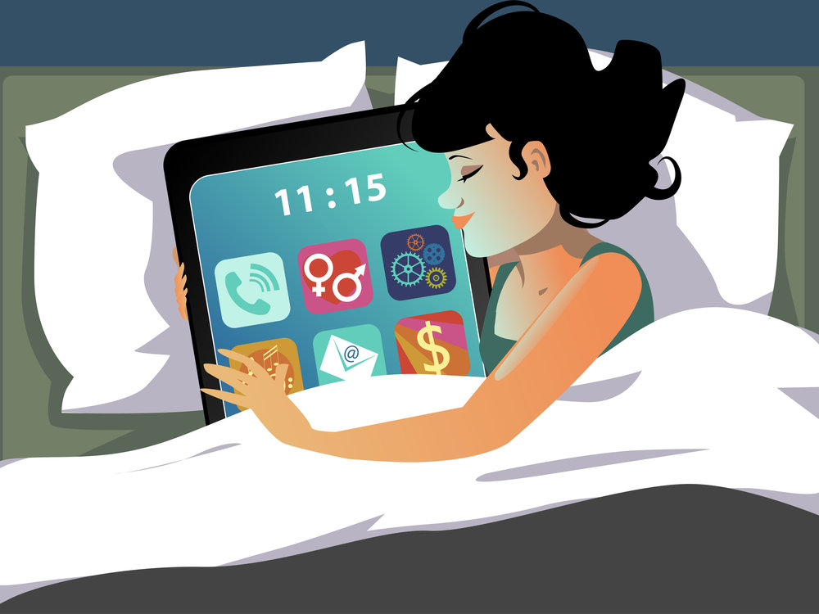
Warning Signs of Addiction to Social Media, phones and/or Gaming
Notes:
Child loses interest in normal activities they once enjoyed, they are secretive about their internet use and hide things from you, they lose connection to school friends and family (withdrawn), they get very agitated when online time is cut short or interrupted and they can’t find other things to do, they keep odd hours and are online at inappropriate times, they change school performance, cannot regulate themselves when not online.
With concerted effort by adults and changing behaviors, much of the damaging impacts of media on children can be significantly reduced, but when efforts in harm reduction do not create the changes you want to see, think about if there is something more serious going on.
Definition: a compulsive need to use your digital devices, to the extent where it interferes with your life and stops you from doing things you need to do or love to do, is the hallmark of an addiction. Has negative consequences on life, but you continue to engage with the activity.
https://www.itstimetologoff.com/digital-addiction/
Underdiagnosis and exact number is hard to find:
Estimated that between 7- 15% of people aged 23-38 admit that they are addicted to social media.
https://www.therecoveryvillage.com/process-addiction/internet-addiction/internet-addiction-statistics/
https://www.searchlogistics.com/grow/statistics/social-media-addiction-statistics/
Addiction is a family disease
Is addiction to screens real?

Slide 26
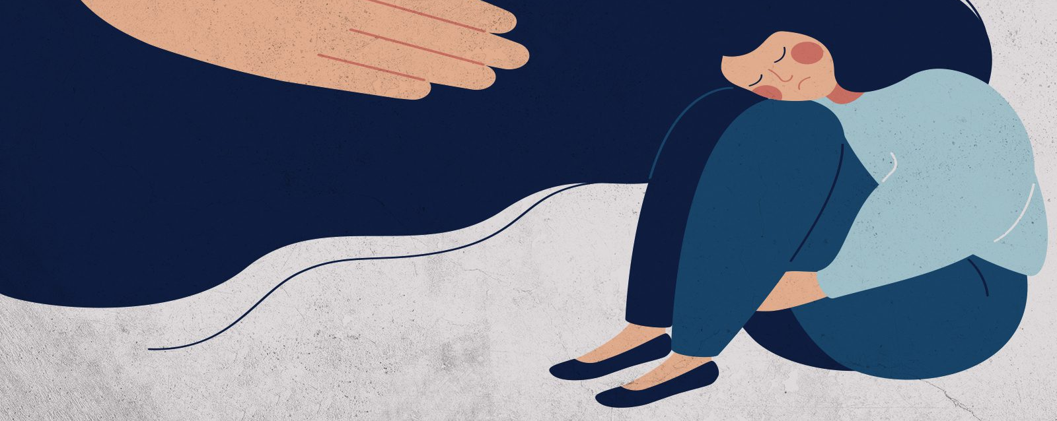
What to DO if You Need Support

Slide 27
Closing Remarks and
Notes:
How did you do on the cell phone challenge we started at the beginning of the presentation?
Cover the 3 Take-Aways
Harm reduction is a perspective to use to keep students and yourself safe while engaging in the use of screens, can be applied to many other parts of life
Draw on the strengths of your community to create a strengths- based approach for integration of technology into learning and for community connection
Screen time is an out-dated term, the impacts of it are diverse. Avoid getting too focused on control, rather think about the communication tools which will create space and discussion for integrating screens into your schools and families.

Slide 28
Resources
Harm Reduction Information: https://harmreduction.org/about-us/
JFCS Parent Coaching: https://jfcsmpls.org/parent-coaching-interest-form/
Common Sense Media: https://www.commonsensemedia.org/articles/how-much-screen-time-is-ok-for-my-kids
Video Game Addiction Support: https://gamequitters.com
AAP on Screen Use:
https://www.aap.org/en/patient-care/media-and-children/
Harm Reduction Information & Crisis Line:
https://www.samhsa.gov/find-help/harm-reduction

Slide 29
References
Larzelere, A. S. Morris, & A. W. Harrist (Eds.), Authoritative parenting: Synthesizing nurturance and discipline for optimal child development (pp. 11–34). American Psychological Association.
Durlofsky, P. (2020). Logged in and Stressed Out: How Social Media is Affecting Your Mental Health and what You Can Do about it. Rowman & Littlefield.
Gorman, T. E., Gentile, D. A., & Green, C. S. (2018). Problem gaming: a short primer. American journal of play, 10(3), 309.
Hansen, Z. (2023). Presentation on Video Gaming Disorder. Hazeldon Betty Ford Clinic.
Howard, Jacqueline. “Americans at more than 10 hours a day on screens.” CNN, Cable News Network, 29 July 2016, www.cnn.com/2016/06/30/health/americans-screen-time-nielsen/index.html.
Sander, G., Shirley-Beavan, S., & Stone, K. (2019). The global state of harm reduction in prisons. Journal of Correctional Health Care, 25(2), 105-120.
Stone K (2014) The Global State of Harm Reduction 2014. Harm Reduction International: London
https://www.house.mn.gov/sessiondaily/Story/17045

Slide 30
References
https://www.pewresearch.org/internet/2020/07/28/parenting-children-in-the-age-of-screens/
https://www.itstimetologoff.com/digital-addiction/
https://www.inc.com/john-brandon/these-updated-stats-about-how-often-we-use-our-phones-will-humble-you.html
https://www.pewresearch.org/fact-tank/2021/03/26/about-three-in-ten-u-s-adults-say-they-are-almost-constantly-online/
Kids on the Web 2021: https://securelist.com/children-report-2021/102527/
https://www.cnbc.com/2021/06/29/child-psychologist-explains-4-types-of-parenting-and-how-to-tell-which-is-right-for-you.html
St. Paul City Government: https://www.stpaul.gov/sites/default/files/Media%20Root/Police/kids%20safety%20summer.pdf
https://www.therecoveryvillage.com/process-addiction/internet-addiction/internet-addiction-statistics/
https://mottpoll.org/reports/top-health-concerns-kids-2020-during-pandemic

Slide 31
I’d love to hear from You:
Leah Persky
lpersky@jfcsmpls.org
Training, parent coaching, and consultations
Questions? Comments?

Slide 32
Baumrind’s Parenting Styles
-What is your style?
-How does this apply to managing screen time for kids?
Notes:
https://www.cnbc.com/2021/06/29/child-psychologist-explains-4-types-of-parenting-and-how-to-tell-which-is-right-for-you.html
Diana Baumrind, 1960’s, Psychologist, University of California
Baumrind, D. (1967). Child care practices anteceding three patterns of preschool behavior. Genetic Psychology Monographs, 75(1), 43-88.

Slide 33
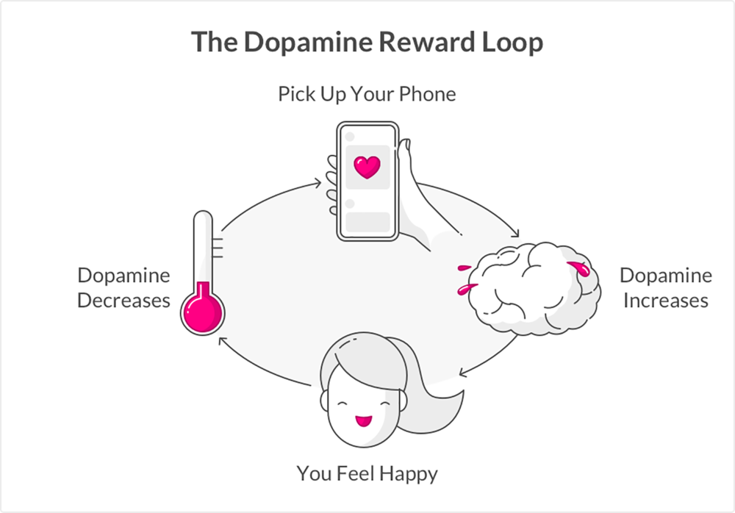
Notes:
https://etactics.com/blog/social-media-and-mental-health-statistics
The developmental stages of kids and teens make them more vulnerable to this rewards loop
Teens are especially sensory seeking and also highly attuned to their peers- they essentially have a device that allows them to seek out these experiences
Self-control is limited for all kids and the developers of apps for kids use the same strategies to increase engagement– similar methods used to the design of slot machines
Add more notes here:

